Slide 1
The Progressive era: An introduction

Slide 2
The Gilded Age
A look back…

Slide 3
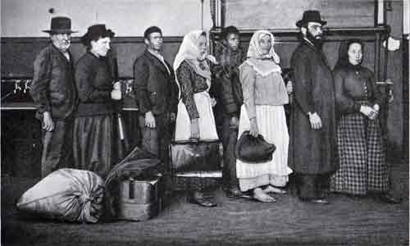
immigration

Slide 4
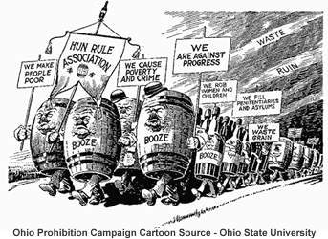
Drunkenness

Slide 5
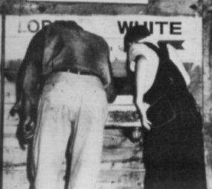
Racial discrimination and violence

Slide 6
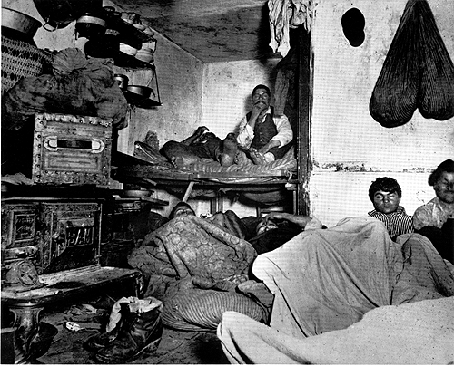
Overcrowding

Slide 7
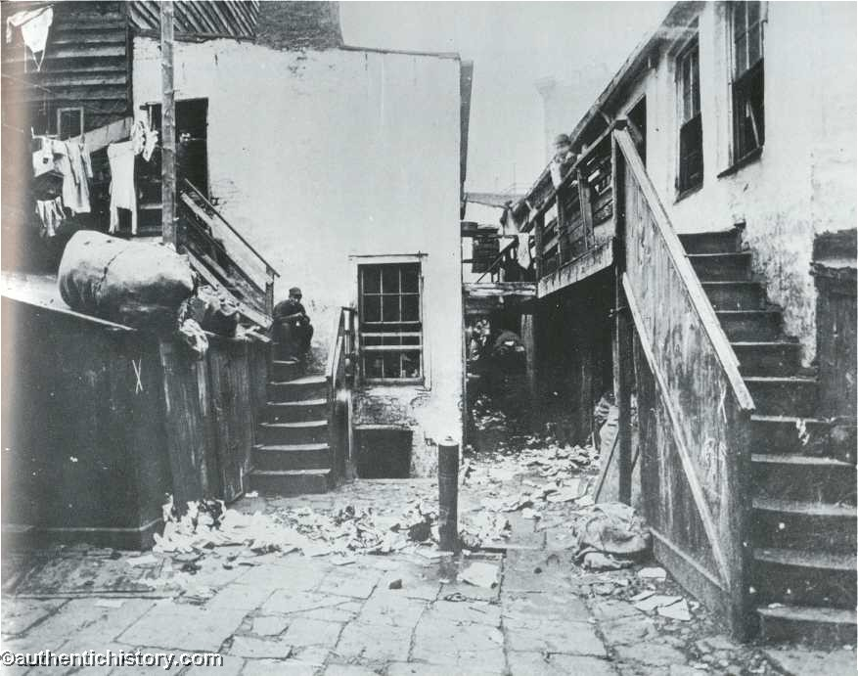
Tenements

Slide 8
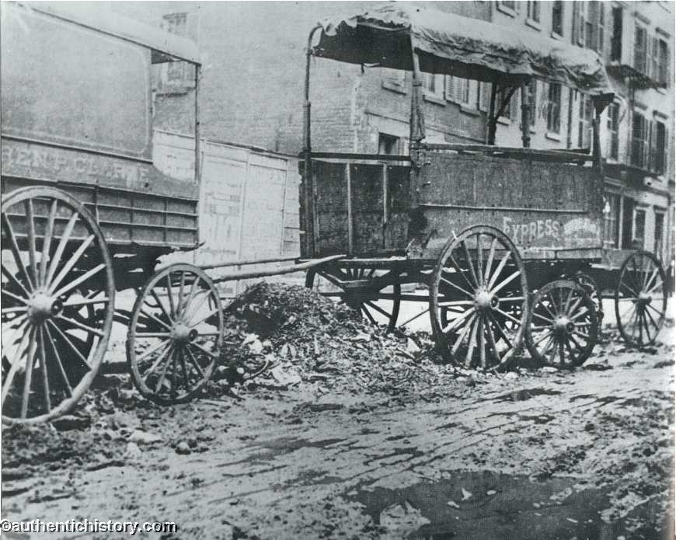
Sanitation

Slide 9
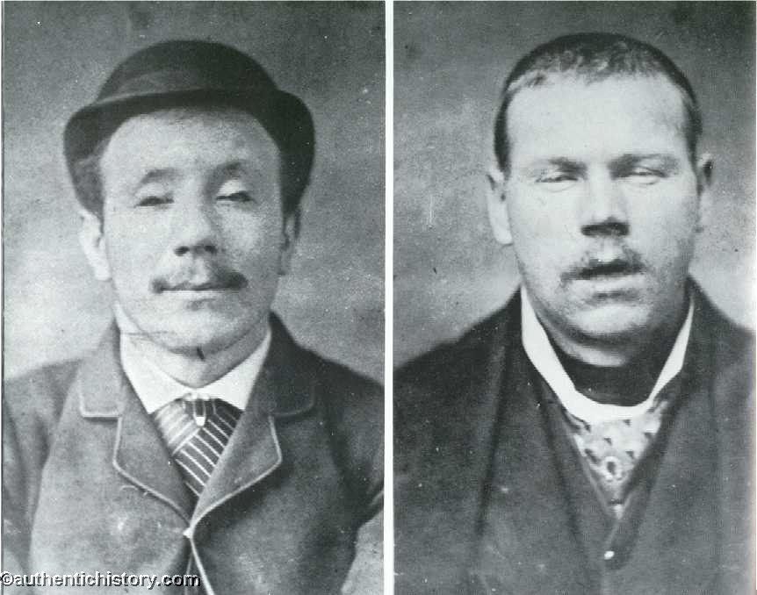
Crime

Slide 10
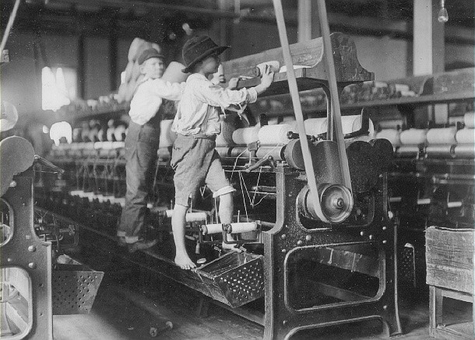
Child labor

Slide 11
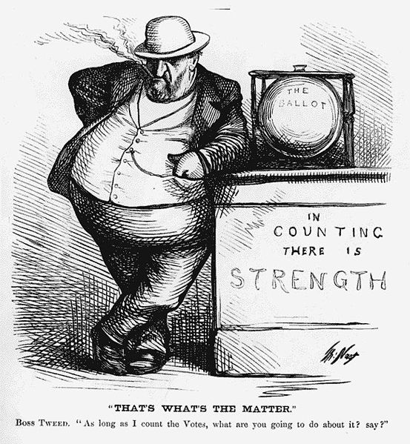
Political corruption

Slide 12
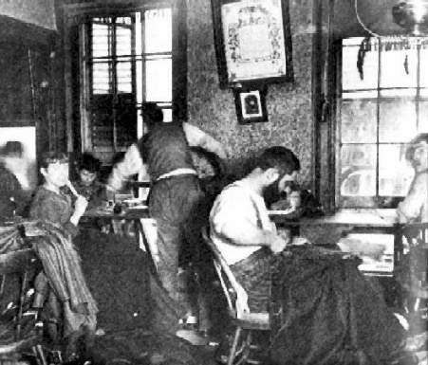
sweatshops

Slide 13
The roots of progressivism

Slide 14
The Roots of Progressivism
New Idea: Government can be used as a tool to promote human welfare
Many Groups Demand Reform
Populists (William Jennings Bryan)
Muckrakers
Social Gospel Movement
Socialists
Feminists

Slide 15
The Progressives: Who they Were

Slide 16
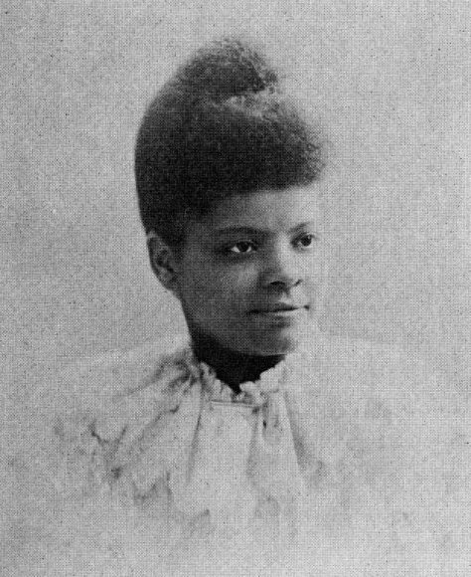
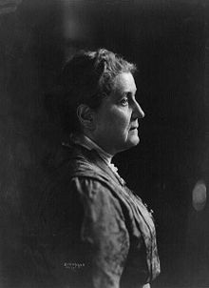
Social reformers
Ida b. wells
- anti-lynching advocate
Jane addams
-Founded the nation’s first settlement house, hull house

Slide 17
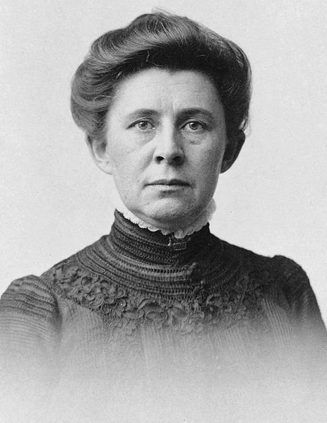
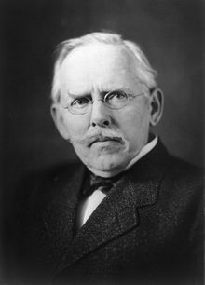
Muckrakers
- Journalists who sought to expose social and political problems
Ida m. tarbell
Jacob riis

Slide 18
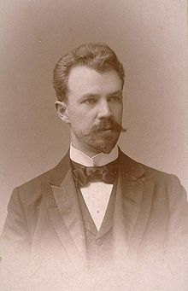
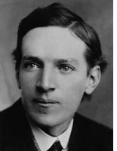
muckrakers
Lincoln steffens
Upton sinclair

Slide 19
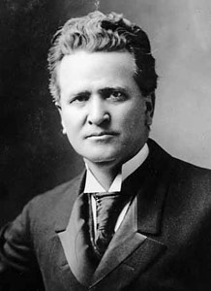
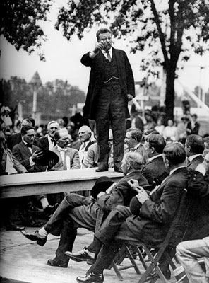
politicians
Theodore roosevelt
Robert
la follette

Slide 20
The goals of progressivism

Slide 21
Protect Social Welfare
Goal: Ease the problems caused by rapid urbanization and industrialization
Reforms:
Agencies like the YMCA and Salvation Army created
Settlement houses helped families
Florence Kelley helped pass the Illinois Factory Act of 1893, which prohibited child labor

Slide 22
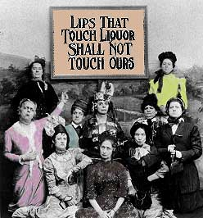
Promote Moral Improvement
Goal: Prohibit the production, sale, and consumption of alcohol.
Reforms:
Groups like the Anti-Saloon League and WCTU protested alcohol consumption
18th Amendment passed in 1920

Slide 23
Create Economic Reform
Goal: Lessen the gap between the rich and the poor and expose corrupt business practices
Reforms:
Exposes written by Muckrakers
Clayton Antitrust Act
Muller v. Oregon limited working hours
Child Labor Legislation
Eugene Debs promoted Socialism

Slide 24
Foster Efficiency
Goal: Apply scientific processes to industry
Reforms:
Scientific Management
Assembly Lines

Slide 25
Reform State and Local Government
Goals: Reduce power held by political machines, eliminate corruption, and give more power to the voters.
Reforms:
Secret Ballot Voting
Initiative: Voters propose laws
Referendum: Voters vote on an intiative
Recall: Voters can force new elections
State Primary Systems: Voters choose candidates
17th Amendment: Direct election of Senators

Slide 26
http://www.youtube.com/watch?v=uFlOLyMwnjU

